Slide 1
Arab-Israeli Wars

Slide 2
Fallout Between British and Jews
The Jewish Agency organized illegal immigration from 1939 through 1942 with the help of the Haganah. Those who arrived illegally to Israel during this time were part of the Aliyah bet. This was a dangerous operation, for these illegal immigrants arrived by boat and had to be careful not to be caught by the British or Nazis. Many of these ships sank or were caught, such as the Patria, Struma and SS Bulgaria. Compared to the number of attempts, few ships actually arrived successfully to Palestine, but tens of thousands of Jews were saved by the illegal immigration.
Despite the reports of Nazi atrocities growing and the desperation of Jews needing a safe haven the British kept the doors of Palestine closed to Jewish Immigration.
The Zionist leaders met in a hotel in Baltimore and concluded that due to the British behavior, the British were an enemy to be fought.

Slide 3
Haj Amin al-Husayni
was the chief organizer of the 1936 general strike (calling for the nonpayment of taxes, shutting down of municipal councils, an end to Jewish immigration, a ban on land sales to Jews, and national independence which resulted Great Revolt against British authority that lasted from 1936-39; was consequently removed by the British from the post of SMC Pres.; escaped a British attempt to arrest him in July 1937, taking refuge at the Haram Ash-Sharif until mid-Oct., then he – disguised as a woman – escaped to Lebanon;
reconstituted the Arab Higher Committee (which the British had declared illegal) and ran the national leadership from exile; also raised funds to improve and restore the Dome of the Rock Mosque in Jerusalem;
established contacts with the Nazis in Germany, where he was welcomed as a leader of anti-British nationalism and met Adolf Hitler in Berlin in 1941;
was named a local leader of the Muslim Brotherhood after its establishment in Jerusalem in the mid-1940s by followers of Hassan Al-Banna, who founded the Brotherhood in Egypt in 1928;
after the war tried to regain control of Palestine from his Egyptian exile from March 1946 and fought against the 1947 Partition Plan;
was elected Pres. in absentia of the Arab Higher Executive (Fourth Higher Committee of the Arab League); was declared Pres. of the All-Palestine Government, which was set up by the first Palestinian National Council on 1 Oct. 1948 in Gaza and which declared an independent Palestinian state
Al-Husseini's tactics, his abuse of power to punish other clans, and the killing of 'traitors', alienated many Palestinian Arabs.

Slide 4
World War II Ends
Defeat of Germany and emergence of new British parliament controlled by the labor party brought new hope to the Zionists
White Paper of 1939 had restricted Jewish immigration
they were confident new government would change it
Foreign Secy Ernest Bevin was sharply aware of Arab plight and was reluctant to provoke renewed violence
When Truman requested Britain admit 100,000 Jewish refugees into Palestine, Prime Minister Clement Atlee countered by inviting US to help study the matter: Anglo-American Commission
Yishuv = name given to Jewish settlements in Palestine before Israel

Slide 5
Violence Resumes
bitterly disappointed by this turn of events, the Irgun & Stern forces resumed terrorist activities against the British as early as 1944
bombing British police stations & killing civil & military officials
In Nov 1944 Stern gang assassinated Lord Moyne, British Minister of State in Cairo
The assassination of Lord Moyne sent shock waves through Palestine and the rest of the world
As well as being the highest British official within reach, Moyne was regarded as personally responsible for Britain's Palestine policy. In particular, he was regarded as one of the architects of Britain's strict immigration policy, and to have been responsible for the British hand in the Struma disaster. According to Bell, Lord Moyne was known to the underground as an Arabist who had consistently followed an anti-Zionist line.
According to Yaakov Banai, who served as the commander of the fighting unit of Stern, there were three purposes in the assassination:
To show the world that this conflict wasn't between a government and its citizens like Britain tried to show but between citizens and a foreign rule.
To prove that the conflict was between the Jewish People and the British Imperialism.
To take the "War of Liberation" out of the Land of Israel

Slide 6
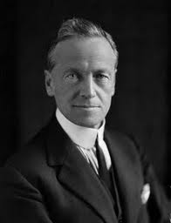
Moyne’s Speech House of Lords 1942
The tragedy of the Palestinian question is, as was said by the Royal Commission, that it is a conflict between two rights. When Jerusalem was destroyed and its site ploughed up in the year 135 A.D., the Jews had occupied the country for about 1,300 years. Since the Mahomedan invasion of 632 the Arabs have occupied Palestine for practically the same period. To these Arabs the Jews are not only alien in culture but also in blood. It is very often loosely said that Jews are Semites, but anthropologists tell us that, pure as they have kept their culture, the Jewish race has been much mixed with Gentiles since the beginning of the Diaspora. During the Babylonian captivity they acquired a strong Hittite admixture, and it is obvious that the Armenoid features which are still found among the Sephardim have been bred out of the Ashkenazim by an admixture of Slav blood.
The Zionist movement has its main spring among those Jews of Poland and Eastern Europe.
Their leaders demand that an already overcrowded Palestine should be trebled in its population by the admixture of another three million Jews immediately after the war. Now it is not a matter of putting a quart into a pint pot, it is a matter of putting exactly three pints into a pint pot. Successive inquiries have shown that immigration on this scale would be a disastrous mistake, and is indeed an impracticable dream. A far smaller measure of immigration led to the Palestine disturbances which lasted from 1936 to 1939, and showed that the Arabs, who have lived and buried their dead for fifty generations in Palestine, will not willingly surrender their land and self-government to the Jews

Slide 7
Backfire
As Moyne’s assassins fled on bicycles, an Egyptian motorcycle policeman pursued, wounding one in leg
captured, they were brought to trial and hung
Stern issued statement in their defense:
"We accuse Lord Moyne and the government he represents, with murdering hundreds and thousands of our brethren; we accuse him of seizing our country and looting our possessions... We were forced to do justice and to fight".
There was reversal in British attitudes toward Zionism: "If our dreams for Zionism are to end in the smoke of an assassin's pistol, and the labours for its future produce a new set of gangsters worthy of Nazi Germany, then many like myself will have to reconsider the position we have maintained so consistently and so long in the past". _{W Churchill}
Indeed a partition plan that would have given Jews a homeland was before the Cabinet for final approval in the same week that Moyne was assassinated, but the assassination caused it to be immediately shelved and never resurrected.

Slide 8
Anglo-American Commission
Carried on investigation in atmosphere of hostility and violence, the commission presented its report on April 30, 1946:
Palestine be neither Jew or Arab state
warned against partition
favored a binational, bilingual state safeguarding rights of Arabs and Jews alike
situation not ripe for independence, mandate should continue pending execution of trusteeship under United Nations
in order to relieve suffering of Jewish refugees in Europe admission of 100,000 Jews
but these would all come to naught as no one could agree
Secretary Bevin blamed US for failure in that during a gubernatorial campaign in New York, candidates promised immigration of some 100,000-175,000 Jews

Slide 9
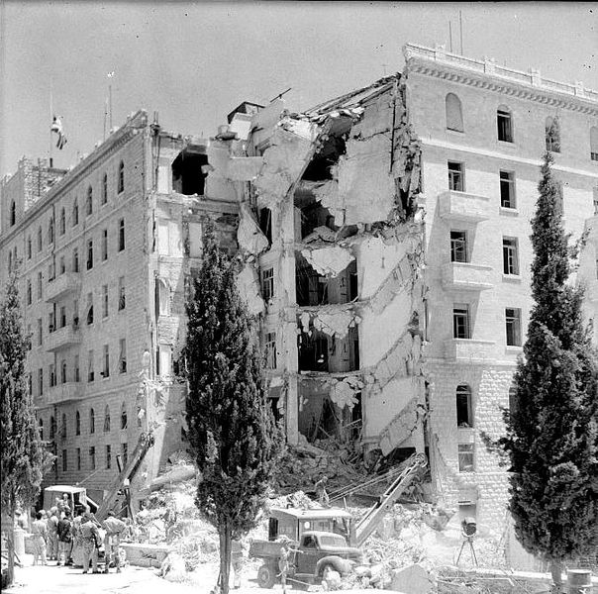
Irgun Terrorism
Irgun tore up rails, blew up refineries, robbed banks, raided ammunition depots, ambushed British soldiers thru 1945
June 22, 1946 bomb exploded in King David Hotel which housed British mandate secretariat, military headquarters killing 91 people

Slide 10
UNSCOP
It appeared that British were not able to solve the problem, if indeed anyone could
On February 18, 1947 Secy Bevin announced that British were submitting the Palestine problem to United Nations
UN formed UN Special Committee on Palestine (UNSCOP) composed of 11 nations: Australia, Canada, Czechoslovakia, Guatemala, India, Iran, the Netherlands, Peru, Sweden, Uruguay & Yugoslavia
when UNSCOP was in Palestine, Irgun staged a daring attack on prison at Acre freeing many Jewish prisoners The Acre Prison break, with other operations had a strong moral effect on the Yeshiva and on the fight for foundation of Israel. It is considered to have seriously damaged the British prestige and sped up to the foundation of the UNSCOP

Slide 11
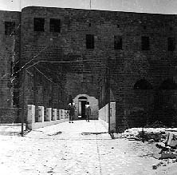
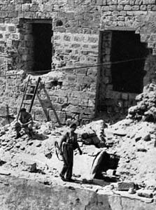
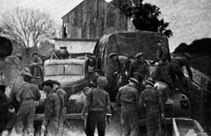
The Jewish Agency called the break "an irresponsible suicidal act", while Irgun commander Menachem Begin hailed it as an act of heroism. Three out of the five men captured were sentenced to death. The Irgun kidnapped two British sergeants,and threatened to execute them should the British carry out the death sentences. When the British did not relent and had the Irgun men executed, the Irgun hanged the two sergeants.

Slide 12
UN Partition Plan 1947
UNSCOP was not able to present unanimous report:
3 countries, India, Iran, Yugoslavia presented a minority opinion recommended a federated Palestine
remaining 8 recommended partition into separate Arab and Jewish states
There was heated debate about how the plan was to be executed and while Zionists favored partition, the Arabs rejected both plans
Finally the consensus was for partition
When put to vote in General Assembly on November 26, 1947 it was not clear that it would receive the necessary 2/3 majority
There were delays during which American delegates put great pressure on those who planned to cast negative votes

Slide 13
UN Partition Plan 1947
On Nov 29, 1947, when it appeared partition plan would pass, the Arab delegation proposed reconsideration of minority plan
This sort of conduct would be a recurring pattern with the Arabs: vehement opposition to a resolution then reversing position to support it after all hope for its approval disappeared
the partition plan was passed by the General Assembly 33 to 13 with 11 abstentions (including Great Britain and China)
Great Britain announced it would terminate the mandate on May 15, 1948

Slide 14
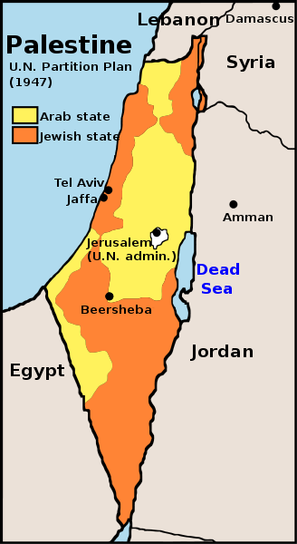
UN Partition Plan 1947
A Jewish State covering 56.47% of Mandatory Palestine (excluding Jerusalem) with a population of 498,000 Jews and 325,000 Arabs;
An Arab State covering 43.53% of Mandatory Palestine (excluding Jerusalem), with 807,000 Arab inhabitants and 10,000 Jewish inhabitants;
An international trusteeship regime in Jerusalem, where the population was 100,000 Jews and 105,000 Arabs

Slide 15
UN Partition Plan 1947
A guarantee of the rights of minorities and religious rights, including free access to and the preservation of Holy Places;
A constitution of an Economic Union between the two states: custom union, joint monetary system, joint administration of main services, equal access to water and energy resources.
The General Assembly also proposed:
A two-month interim period beginning 1 August 1948, date of expiry of the mandate when the British troops were to be evacuated, with a zone including a port to be evacuated in the territory of the Jewish State by 1 February;
A five-country Commission (Bolivia, Denmark, Panama, Philippines, Czechoslovakia) in charge of the administration of the regions evacuated by Great Britain, of establishing the frontiers of the two states and of setting up in each of them a Provisional Council of Government;
The gradual take-over of the administration by the Provisional Council of Government in both States, and the organization of democratic elections for a Constituent Assembly within two months.

Slide 16
Civil War in Palestine
the next day a brutal civil war erupted between Jews and Palestinian Arabs, this time British forces did not intervene
Palestinian Arabs received arms from neighboring Arab countries
Jews received arms from US and Czechoslovakia
atrocities were committed by both sides:
Jan ‘48 Irgun blew up Arab Semiramis Hotel in Jerusalem
Arabs retaliated by bombing the Jerusalem Post bldg
In Feb, a bomb exploded in crowded market of Ramleh
two days later one exploded in crowded Tel Aviv
Arab village of Deir Yassin was captured by Haganah and turned over to Irgun-Lehi forces which murdered some 107 to 254 Arab men, women and children
Arabs then ambushed a hospital convoy killing 80 doctors, nurses and medical students

Slide 17
The Jordanian newspaper Al Urdun published a survivor's account in 1955, which said the Palestinians had deliberately exaggerated stories about atrocities in Deir Yassin to encourage others to fight, stories that had caused them to flee instead. Everyone had reason to spread the atrocity narrative. The Irgun and Lehi wanted to frighten Arabs into fleeing; the Arabs wanted to provoke an international response; the Haganah wanted to tarnish the Irgun and Lehi; and the Arabs and the British wanted to malign the Jews. In addition, Milstein writes, the left-wing Mapai party and David Ben-Gurion, who became Israel's first prime minister on May 14, exploited Deir Yassin to stop a power-sharing agreement with the right-wing Revisionists—who were associated with Irgun and Lehi—a proposal that was being debated at the time in Tel Aviv. Mordechai Ra'anan, the Irgun commander in Jerusalem, told reporters on April 10 that 254 Arab bodies had been counted, a figure published by The New York Times on April 13. In 1987, in a study regarded as authoritative, Sharif Kan'ana of Bir Zeit University concluded by interviewing survivors that 107 had died, with 12 wounded.

Slide 18
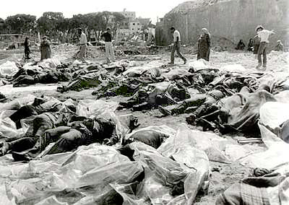
Deir Yassin Massacre April 29, 1948

Slide 19
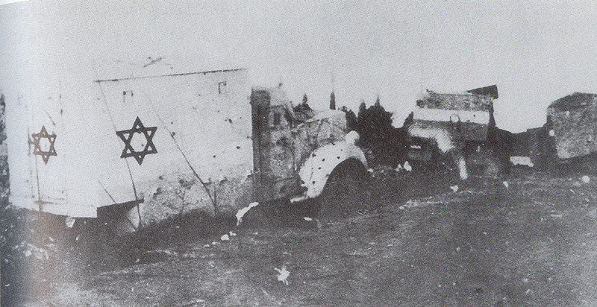
Hadassah Medical Convoy Massacre

Slide 20
Aftermath
The effect of the civil war generated a massive exodus of Arab refugees numbering 150,000
Jewish civilians were not permitted to evacuate without permission of Haganah
these settlers kept Palestine land occupied by Jews and in effect established their borders where as yet none had been defined
At same time UN delegates were trying to hammer out the difficulties in implementing the partition plan
they received harsh criticism from Zionists

Slide 21
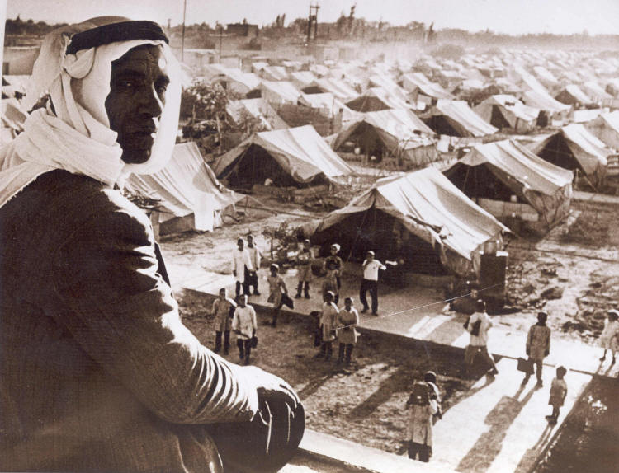

Slide 22
Israel Becomes a Nation
The effects of the violence was intense and received much international condemnation
Palestinian Arabs began to flee mounting up a large number of refugees (est. 250,000)
neighboring Arabs states determined to take action against Israel
Jews were not allowed to leave without approval by Haganah, their continued present meant the land was permanently “settled”
While UN sought desperately for a solution, Ben Gurion and members of the National Council of the Jewish State in Palestine gathered in Tel Aviv and declared Israel an independent state on May 14, 1948
within minutes, Truman announced recognition of the new State of Israel
Chaim Weizmann was chosen as the first president and David Ben Gourion was the first Prime Minister

Slide 23
First Arab-Israeli War 1948
A friend of the British, King Abdullah of Transjordan was known for moderation but news of the massacre at Deir Yassin changed his mind
On May 15, 1948, not 24 hours after Israel was declared a nation, he and five other Arab nations declared war on Israel:
Egypt, Iraq, Jordan, Lebanon, Saudi Arabia, Syria
combined population of 40 million against some 650,000 Jews in Palestine at the time
For the first time since Jews came to Palestine, they were involved in a life-or-death struggle for their very existence.

Slide 24
Arab-Israeli War 1948
On other hand, both sides poorly equipped, Jews fared better:
Haganah had 60,000 combatants of which 20,000 were seasoned WWII veterans and 300 British-trained officers
Palmach had 3,000 specially trained commandos
combined forces of Irgun and Lehi (Stern) were less than a thousand
Combined Arab forces numbered a mere 70,000 of inexperienced, poorly led troops with exception of 6,000-member Arab Legion under Glubb Pasha
Arabs lacked unified command because of divided interests

Slide 25
Arab-Israeli War 1948
Abdullah's role in this war became substantial. He saw himself as the "supreme commander of the Arab forces" and "persuaded the Arab League to appoint him" to this position.
Through his leadership, the Arabs fought the 1948 war to meet Abdullah's political goals.
Hostile towards Palestinian nationalism, Abdullah wished to annex as much of Palestine as possible but was willing to compromise. He supported partition plan
King Farouq of Egypt was anxious to prevent Abdullah from being seen as the main champion in Palestine
he wished to annex southern portions of Palestine for Egypt
Nuri as-Said, the strongman of Iraq, had ambitions for bringing the entire Fertile Crescent under Iraqi leadership.
Both Syria and Lebanon wished to take certain areas of northern Palestine
all shared a disdain for al-Huayni who wished to set up an Arab state and mutual distrust of each other
The Arab League blocked recruitment to al-Husayni's forces, which collapsed following the death of his most charismatic commander, his cousin Abd al-Qadir al-Husayni

Slide 26
Arab-Israeli War 1948
First phase of the war did not go well for Israel
Egyptian troops, joined by large number of volunteers from Muslim Brotherhood invaded from the south taking the Negev
WWII vintage Egyptian planes took to skies with impunity first few weeks and bombed Tel Aviv
Jordanian Arab Legion took East Jerusalem
Iraqi soldiers pushed into the north 15 miles from Haifa
A cease fire was imposed on the Arabs and Jews by the UN on June 11, 1948, it lasted 4 weeks, which included arms embargo and restriction on reinforcement
The Israeli Defense Forces were able to acquire weapons from Czechoslovakia as well as improve training of forces and reorganization of the army during this time
Israel increased troop strength from 30,000 to 65,000
Jewish pilots from America flew in B-17 bombers and British Beaufighters

Slide 27
Arab Legion
During the 1948 Arab–Israeli War the Arab legion was considered the strongest Arab army involved in the war. Glubb led the Arab Legion across Jordan to occupy the West Bank. Despite some negotiation and understanding between the Jewish Agency and King Abdullah, severe fighting took place in Kfar Etzion, Jerusalem and Latrun.
Rumours that Abdullah was once again in contact with the Jewish leaders further damaged his standing in the Arab world. His many critics suggested that he was prepared to compromise the Arab claim to the whole of Palestine as long as he could acquire part of Palestine for himself. 'The internecine struggles of the Arabs,' reported Glubb, 'are more in the minds of Arab politicians than the struggle against the Jews. Azzam Pasha, the mufti and the Syrian government would sooner see the Jews get the whole of Palestine than that King Abdullah should benefit.'
Glubb remained in charge of the defence of the West Bank following the armistice in March 1949, and as the commander of the Arab Legion until 1 March 1956, when he was dismissed by King Hussein who wanted to distance himself from the British and disprove the contention of Arab nationalists that Glubb was the actual ruler of Jordan.
Despite his decommission, which was forced upon him by public opinion, he remained a close friend of the king.

Slide 28
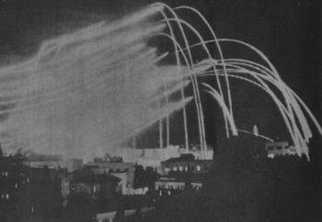
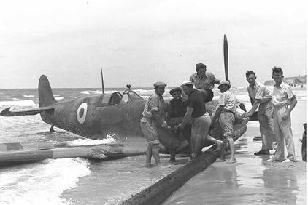
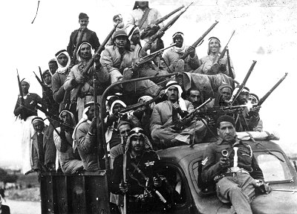
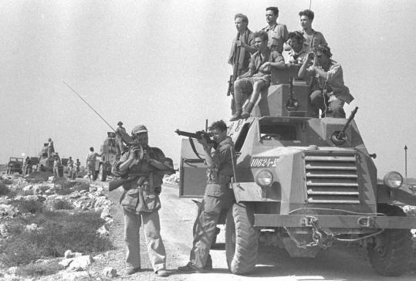
Jordanian Artillery Fire Over Jerusalem 1948
Egyptian Spitfire Shot Down Over Tel Aviv

Slide 29
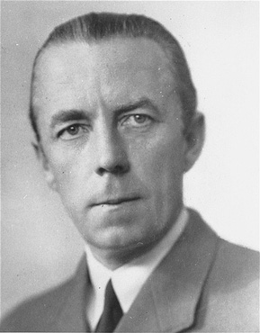
Arab-Israeli War 1948
UN Negotiator Count Folke Bernadotte of Sweden tried to negotiate a truce. His proposal to unify Jordan and Palestine in one Arab state and maintain Jewish atonomy in another state was rejected by both Jews and Arabs
Fighting resumed on July 9. This time Israel made considerable gains. Now Jerusalem was split down middle by barbed wire fence
Fighting lasted only ten days but Israel managed to regain lower Galilee, secure a corridor between Jerusalem and Tel Aviv.
Israeli planes bombed Damascus for the first time bringing the war to the Arabs home country
The UN imposed a second cease fire on July 19
Again Israel built up forces while the Arabs had more difficulty doing so.

Slide 30
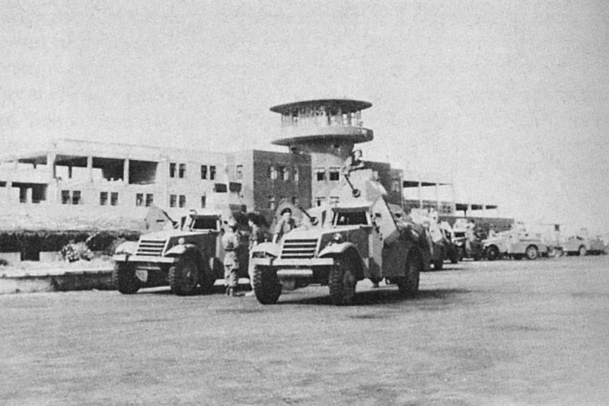
Israeli Armored Vehicles at Airport After the Capture of Lydda

Slide 31
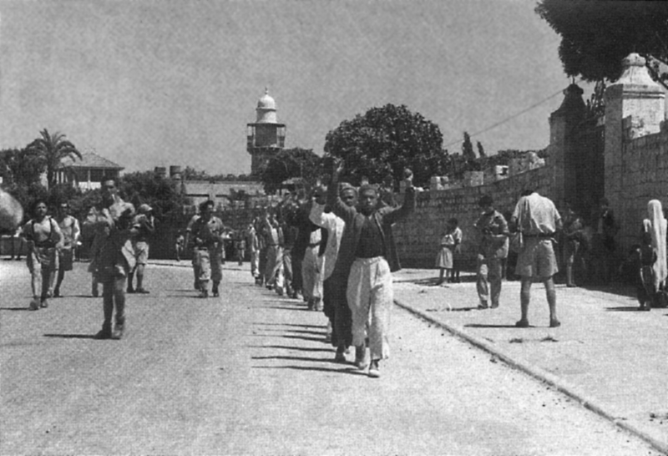
Arab Forces Surrender at Ramla

Slide 32
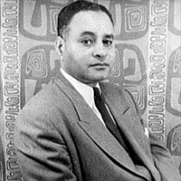
Arab-Israeli War 1948
Count Bernadotte was still working to negotiate a truce when he was killed by Sternist’s bullet on Sept 17, 1948
Fighting resumed for third time in the end of September. By October 31, Israelis gained air superiority and were able to push the Egyptians out of Negev and the Iraqi/Syrian forces out of Galilee.
Ralph Bunche of UN Secretariat was appointed new negotiator for a truce
At his headquarters on the Island of Rhodes he gathered Arab and Israeli representatives in different rooms (as they refused to sit at the same table)
He moved from room to room and negotiated the first armistice between Egypt and Israel on Feb 24, 1949
The others followed suit: Lebanon on March 23, Jordan April 3, Syria on July 20
for this Bunche received well-deserved Nobel Peace Prize
Arab Legion still held West Bank & Old Jerusalem

Slide 33
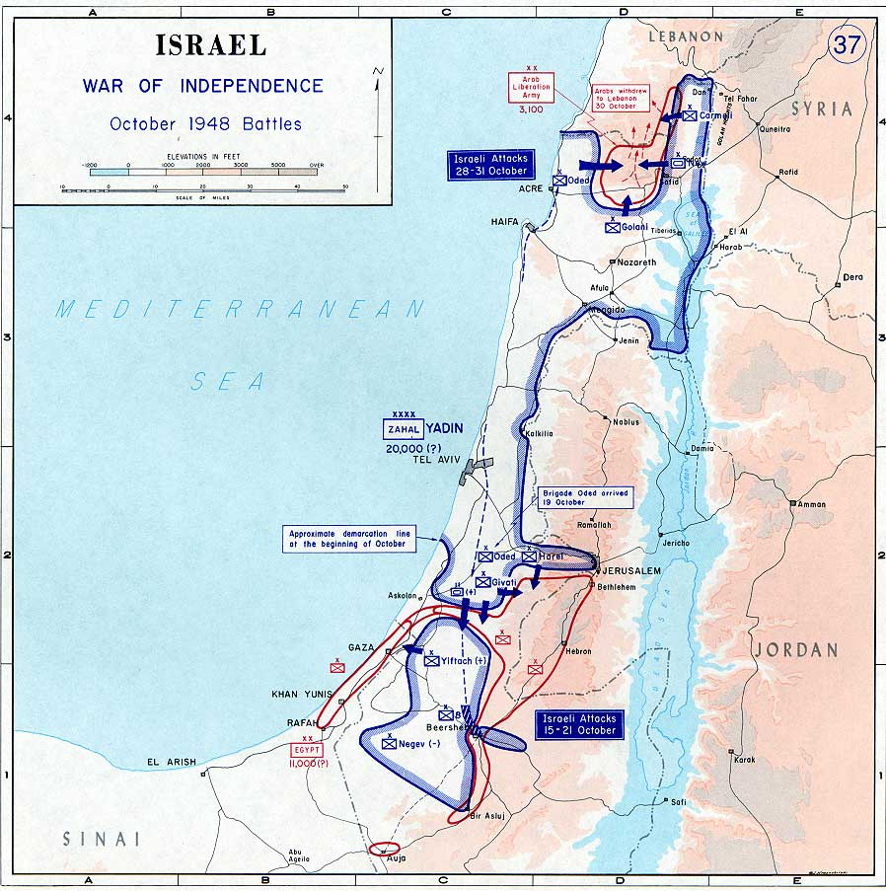

Slide 34
Three Unresolved Issues
No boundaries established by armistice
UN did not insist that Israel go back to the 1947 partition plan lines
Israel rapidly settled new lands gained in 1948 war
Jerusalem was divided by barbed wire instead of being international zone
Israel occupied New Jerusalem and in 1949 proclaimed it to be the new capital and moved the Knesset and other government ministries there
Arab refugees now numbered 750,000
although UN maintained right of these to return to their lands, Israel has refused. These were placed in camps in Gaza Strip, Jordan, Lebanon and Syria.
Israel offered to compensate the Arabs for their losses in exchange for a comprehensive peace treaty with Arab states but the Arabs have refused to do so.

Slide 35
Aftermath of 1948 War
The armistice was fatally flawed. The UN did not insist that Israel return to the original partition lines of Resolution 181 and thus failed to define the political and territorial boundaries of the new states in Palestine.
Jordan controlled the West Bank (of the Jordan River) and the Arab sections of Jerusalem and Egypt occupied the Gaza Strip. That was all of the entire former British mandate of Palestine that remained in Arab hands.
This gave Israel 20% more of Palestine than was specified in the original UN Partition Plan (55% + 20% = 75%).
Despite UN insistence that Jerusalem be demilitarized and under international control, in 1949, Israel declared Jerusalem to be their capital and actually moved the legislative body, Knesset, and many of the government ministries there.
Thus while the Jordanians controlled the Old City and Bethlehem along with many of the holy shrines of Islam, Christianity and Judaism, the Israelis occupied the larger New Jerusalem, dividing the city.

Slide 36
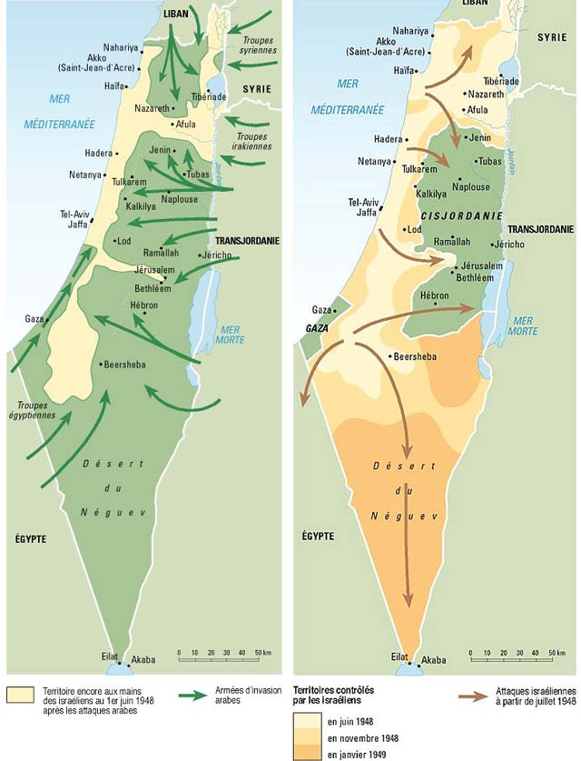
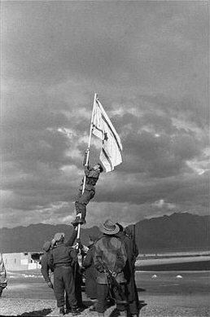
Israelis Raise Flag After Capturing Red Sea Port of Eilat 1949

Slide 37
1949 Armistice
What was achieved was that Israel secured her borders and ports and multiplied the amount of land three fold.
With the Sinai, Israel could prevent blockade of the Gulf of Aqaba and the Suez Canal.
The Golan Heights allowed Israel to control the strategic heights commanding Sea of Galilee and upper Jordan River. [
During Armistice talks of 1949, Israel called for the removal of all Syrian forces from the former Palestine territory.
Syria refused, insisting on an armistice line based not on the 1923 international border but on the military status quo.
The result was a compromise.
Under the terms of an armistice signed on July 20, 1949, Syrian forces were to withdraw east of the old Palestine-Syria boundary.
Israeli forces were to refrain from entering the evacuated areas, which would become a demilitarized zone.

Slide 38
Palestinian Nationalism
In 1948 the Palestinian Arabs ceased to have any significant geographic identity but this did not diminish Palestinian nationalism.
Before World War I nationalism was identified with the Ottoman Empire
With the demise of the Ottoman Empire in 1918, nationalistic focus shifted to more localized forms: Egyptian, Iraqi, Syrian, Jordanian, Palestinian, etc.
Under the British mandate, Palestinian nationalism was initially expressed with peaceful resistance, then in 1928 radicalization as Arabs faced increasing competition from Jewish settlers.
1936-1939 there was the Arab Revolt with increasing violence, followed by a lull during World War II.
In 1944 through 1948 resistance continued growing into all out civil war.
After 1948, Palestinians entered a “lost” phase characterized by shock and silence until 1952 when Gamal Abdul Nasser gave them some sense of identity. Palestinian nationalism lost its geographic focus and became absorbed into a more powerful and encompassing Arab nationalism known as Pan-Arabism whose rallying cry was for the liberation of Palestine.

Slide 39
Struggles in Transjordan in Wake of Arab-Israeli War of 1948
On 20 July 1951, rumors were circulating that Lebanon and Jordan were discussing a joint separate peace with Israel. Abdullah was in Jerusalem to give a eulogy at a funeral and for a prearranged meeting with Jewish diplomats. Abdullah was shot while attending Friday prayers at the Dome of the Rock in the company of his grandson, Prince Hussein. The Palestinian gunman, motivated by fears that the old king would make a separate peace with Israel, fired three fatal bullets into the King's head and chest. Abdullah's grandson, Prince Hussein, was at his side and was hit too. A medal that had been pinned to Hussein's chest at his grandfather's insistence deflected the bullet and saved his life.
Ten conspirators were accused of plotting the assassination and were brought to trial in Amman. The prosecution named Colonel Abdullah el Tell, ex-Military Governor of Jerusalem, and Dr. Musa Abdullah Husseini as the chief plotters of "the most dastardly crime Jordan ever witnessed.“ The Jordanian prosecutor asserted that Col. Tell, who had been living in Cairo since January 1950, had given instructions that the killer, made to act alone, be slain at once afterward to shield the instigators of the crime. Jerusalem sources added that Col. Tell had been in close contact with the former Grand Mufti of Jerusalem, Amin al-Husayni, and his adherents in Arab Palestine. Tell and Dr. Husseini, and three co-conspirators from Jerusalem were sentenced to death. On 6 September 1951 Dr Musa Ali Husseini, 'Abid and Zakariyya Ukah, and Abd-el-Qadir Farhat were executed by hanging.
Abdullah was succeeded by his son Talal; however, since Talal was mentally ill, Talal's son Prince Hussein became the effective ruler as King Hussein at the age of seventeen. In 1967 Abdullah el Tell received a full pardon from King Hussein. Once Hussein became king, the assassination of Abdullah was said to have influenced Hussein not to enter peace talks with Israel in the aftermath of the Six-Day War in order to avoid a similar fate as his grandfather.

Slide 40
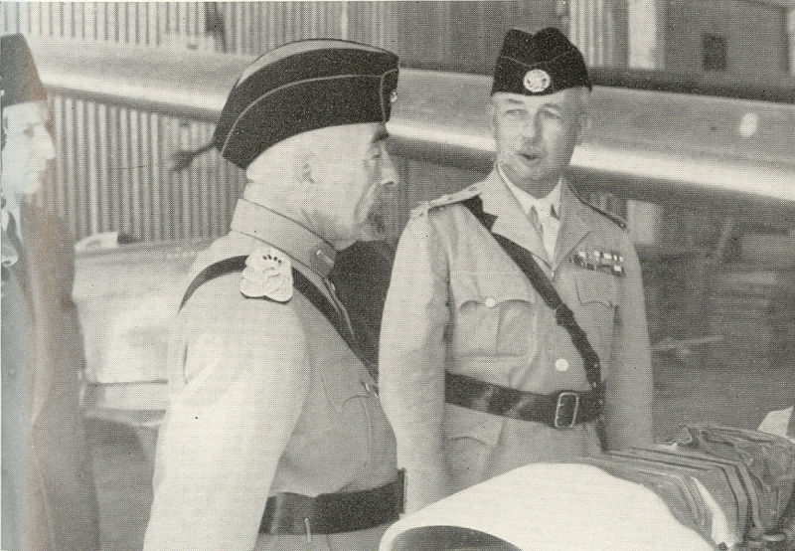
King Abdullah & Glubb Pasha the day before his assassination

Slide 41
Rise of Pan-Arabism
In Egypt, British presence in Suez continued after World War II despite granting Egypt independence in 1922
Treaty of 1936, recognized Egypt as sovereign state in exchange for British military presence of not more than 10,000 troops in canal zone
The agreement was for 20 years, to expire in 1956
The constitutional monarchy under King Farouq entered into fragile existence with growing power of dissenting militant parties (Muslim Brotherhood)
Wafd Party dominated Parliament until its leader, Prime Minister Zaghlul died in 1935.
Afterwards it struggled for control as two of its prime ministers, Ahmad Pasha and Nuqrashi Pasha were assassinated by the Muslim Brotherhood in the late 1940s.
In retaliation, the government gunned down Hasan al-Banna in the streets. The Brotherhood struggled to recover after the loss of their leader as there was dissention among them.
Many of the Brotherhood found their way into the Egyptian Officer Corps.

Slide 42
Mounting Anti-British Violence
Unlike Palestine, the Suez canal was of paramount importance to British strategic goals
especially with the advent of Cold War
Since the 1930s, anti-British sentiment mounted in Egypt, at first with Wafd Party
Prime Minister Nahas Pasha pressed for British evacuation of Canal, ceding of Sudan to Egypt
In 1951, he cancelled the Treaty of 1936, proclaiming Farouq King of Sudan as well as Egypt
with government encouragement, mobs began attacking Western businesses and British forces
Egyptian laborers in the canal zone staged a general strike

Slide 43
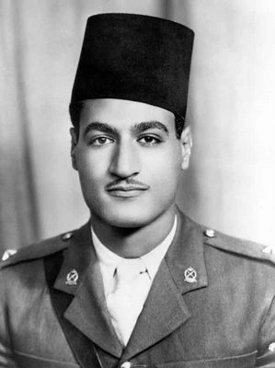
This was the background in which a brilliant young Egyptian army officer, Gamal Abd al-Nasser began his political career.
Even in high school, Nasser had taken part in demonstrations for Egyptian independence.
He had studied the life of Zaghlul and other nationalists and the ideas of the Soviet revolution.
After the war with Israel in 1948, he formed an organization of young army officers called the Free Officers with the specific aim of capturing political power.
It consisted of two communist-oriented officers,
five members of the Muslim Brotherhood and
many ardent Egyptian nationalists uncommitted to any political ideology.
By the early 1950’s the Free Officers grew in size to several hundred members.
Although there was no common ideology, they were united by three principles:
first, elimination of the monarchy,
second, ending British imperialism in Egypt and
third, using the armed forces to achieve these political objectives.

Slide 44
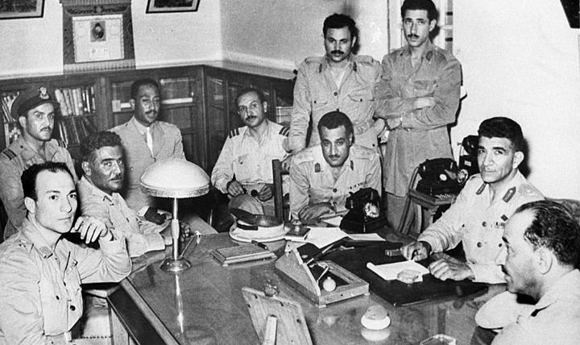
Free Officer Movement

Slide 45
Coup d’Etat 1952
On 25 January 1952, British attempts to disarm a troublesome auxiliary police force barracks in Ismailia resulted in the deaths of 41 Egyptians.
This in turn led to anti-Western riots in Cairo, heavy damage to property and deaths of several foreigners, including 11 British citizens.
The government felt hopeless. The Wafd Party had failed to achieve their goals by peaceable means and this was catalyst for the removal of the Egyptian monarchy.
On 23 July 1952 a military coup by the 'Free Officers Movement'—led by Gen Muhammad Negib and future Egyptian President Gamal Abdul Nasser—overthrew King Farouq and established an Egyptian republic
King Farouq waited for British assistance which failed to materialize. Nasser’s forces took the capital with little resistance. King Farouq was forced to abdicate permanently.

Slide 46
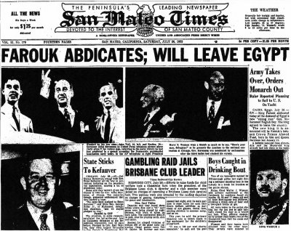
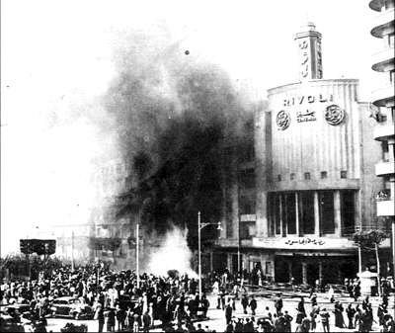
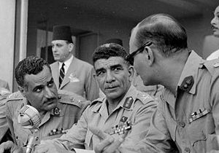

Slide 47
New Egypt under RCC
The Young Officers hoped to purge the government of corruption to allow an “honest” nationalistic civilian rule to take its place.
When no one rose to the challenge, they decided to form a Revolutionary Command Council (RCC) instead. Trying to feel their way through the revolution, the inexperienced young officers enlisted the help of General Muhammad Nagib to serve as Prime Minister.
The RCC dismissed some 800 ministers from government positions, retired some 100 senior military officers and banned all parties except the Muslim Brotherhood temporarily until the new government could be stabilized.
This signaled the end of Wafd Party

Slide 48
Early Struggles of RCC
The Free Officers had taken a bold stroke and their opponents were numerous and strong.
They included the older politicians whose jobs were at stake,
the Communists who had made a foothold in the region,
the wealthy landlords whose fortunes were being affected by the land reform and eventually,
the Muslim Brotherhood who disagreed with the secular approach the RCC was taking.
Nasser rose to the forefront as the true head of the RCC, but General Nagib had acquired the popular support of the people and attributed to him the leadership of the revolution.
In addition, Nagib demanded restoration of the Parliament, recalling that some of these older politicians had nationalistic zeal.
From these events grew a rift between Nasser and Nagib.
As Nagib tried to reform the revolution, Nasser worked to discredit him.
When Nasser prematurely attempted to dismiss Nagib, the people started an uproar in opposition to the RCC on Nagib’s behalf.
The RCC was forced to reinstate Nagib,
declare Egypt as a republic and
promote Nagib to the office of president.

Slide 49
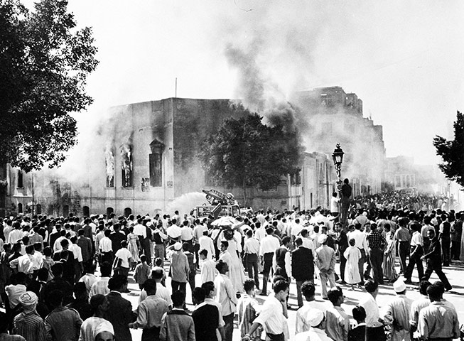
Destruction of Muslim Brotherhood
In October 1954, a member of the Muslim Brotherhood made an unsuccessful assassination attempt on Nasser.
The RCC sprang into action, outlawing the Muslim Brotherhood and purging its members from the RCC,
its leaders fled to other Arab nations
accusing Nagib of being an accomplice to the assassination the RCC ousted him permanently.

Slide 50
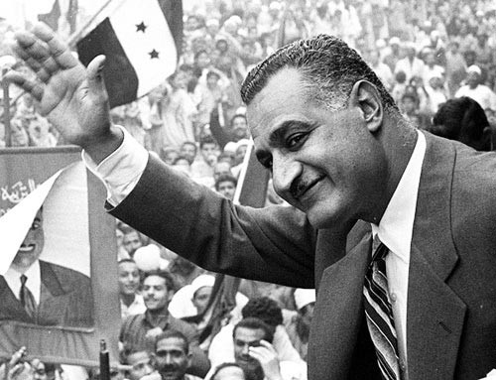
Following the assassination attempt, he climbed unscathed to the podium and proclaimed “My countrymen, my blood spills for you and for Egypt. I will live for your sake and die for the sake of your freedom and honor. Let them kill me; it does not concern me so long as I have instilled pride, honor and freedom in you. If Gamal Abdel Nasser should die, each of you shall be Gamal Abdel Nasser.” The combination of Nasser’s charisma and genuine desire to rejuvenate national pride was a huge success.
Nasser emerged as the acknowledged leader of the revolution and promised to institute constitutional reform by 1956.
He worked hard to gain the trust and respect of the Egyptian people.

Slide 51
Nasser Establishes a Socialist Egypt
In keeping with socialist revolutions, Nasser enacted agrarian reform, strengthened Egypt’s infrastructure including the construction of the High Aswan Dam to control the flood stages of the Nile.
In 1956, a new constitution was promulgated and the regime adopted socialist reform policies.
In 1962, the political party became the Arab Socialist Union with an elaborate organization to ensure participation of the masses in the political process.
Nevertheless, there was the ever present secret police or mukhaberat to strike fear in the hearts of Nasser’s political opponents.

Slide 52
Egypt’s Relations with World
All this took place at the height of the Cold War which polarized the globe into either the Communist bloc or free West camps.
Up until now, the major Arab leaders such as the shah of Iran, King Hussein of Jordan, the Turkish ruling junta and the fledgling monarchs of the Arabian peninsula had all cast their lots among the Western powers.
Nasser, partly out of despite for the imperialism of the British and partly to bolster his populist image joined the ranks of the non-aligned movement, espousing a policy of positive neutrality that in theory was not aligned with either the Communists or the West.

Slide 53
Egypt’s Relations with Arab World
Unlike Turkey, Egypt, even though not Arab, could not be removed from Arab cause and events in Palestine
Nasser’s nationalist movement was felt far beyond the borders of Egypt and emerged as a hero having shed the imperialist yoke first.
Egypt was the model country and Nasser was the model leader promoting pan-Arabism
nevertheless, his movement had Cairo at its center
Syria and Iraq were particularly incensed, considering Damascus or Baghdad as center
Fertile Crescent determined fate of Egypt and Israel cut this historic link
the moderate General Nagib did not object to the existence of Israel as long as there were Muslim ties through Negev

Slide 54
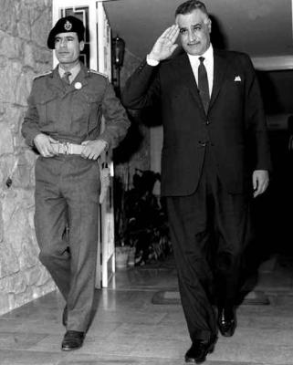
Nasser’s Wide Influence
Nasser’s idealism and charisma was revitalizing to Muslim’s worldwide
He influenced other young officers (shown here with young Quddafi in 1969)
soon there would be military coups in Syria, Iraq and Libya
He purchased arms from USSR and supported fedayi’in activities against Israel

Slide 55
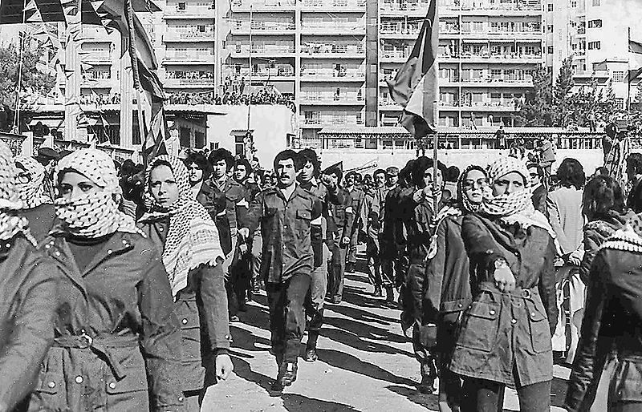
Palestinian Fedayi’in
Emerging from Arab refugees of 1948 War, they were pattern after guerillas of Vietnam, China and Latin America
in the mid 1950s the fedayi’in began mounting cross-border operations into Israel from Syria, Egypt and Jordan. The earliest infiltrations were often to access the lands and agricultural products they had lost as a result of the war, or to attack Israeli military, and sometimes, civilian targets.
Socialist ideology, proclaimed purpose was to defeat Zionism, "liberate Palestine" and establish it as "a secular, democratic, nonsectarian state“
Israel undertook retaliatory actions targeting the fedayi’in and their host countries, which in turn provoked more attacks.

Slide 56
Rift Between US and Egypt
Most important to Egypt’s poor economy was to control the waters of the Nile and to recover desperately needed farm land
The project was so ambitious, it required a billion dollars in 1956
Not willing to get entangled with the tentacles that came from deals with the USSR, Nasser turned to the US and the World Bank
By now, the US was fully focused on the Cold War that Secretary of State John Foster Dulles did not take kindly to “neutrality “ and sought for harsh terms
Nasser let it be known in January that the Western terms amounted to a demand for “the control of the Egyptian economy.” He turned to the Soviets in search of a better offer
He became agitated and finally interrupted Dulles with an explosive cry: “Please don't say you are going to withdraw the offer! Because, you see, we have the Russian offer to finance the dam right here.” And as he said “here,” he patted his pocket, meaning “we have it virtually completed,” not that it was physically in his pocket.
Not recognizing this as a desperate plea to reconsider, but taking it for impudent bravado, an irritated Dulles, who always hated to be maneuvered, retorted: “Well, then, as you already have the money, you have no need of our support. The offer is withdrawn.”
For Hussein it was as abrupt as a punch in the stomach, and as humiliating as spit in his face. The meeting, expected to last at least an hour and a half, was over in fifty minutes

Slide 57
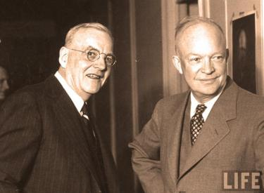
“Dear Mr. President: You asked whether our withdrawal from the Aswan Dam project could properly be deemed 'abrupt.' I think not, at least so far as Egypt was concerned…. “If I had not announced our withdrawal when I did, the Congress would certainly have imposed it on us, almost unanimously. As it was, we retained some flexibility. “Of course Egypt, in its flirtations with the Soviet Union, had itself consciously jeopardized our sharing in this project, and they had tried to bluff us by pretending to [accept] Soviet 'offers.' “The outcome was not in fact anything in the nature of a 'shock' or 'surprise' to the Egyptians. Faithfully yours, John Foster Dulles”

Slide 58
Suez Crisis
In retaliation for US refusal to support the Aswan High Dam project, one week later on July 26, 1956, Nasser nationalized the Suez Canal Company
France and Britain reacted vehemently against Nasser accusing him of jeopardizing the more than half of the European oil passing through the canal
first they froze Egyptian assets while they mobilized naval and armed forces
British and French ships refused to pay dues for using canal and pulled back their canal pilots
Britain and France tried every means in their political power to force Egypt to recant but were unsuccessful.

Slide 59
Suez Crisis
Meanwhile, on Oct 29, 1956 Israel invaded Egypt’s Sinai peninsula in retaliation for the Fedayi’in attacks, advancing to canal zone. Nasser mobilized his forces on the other side confronting them.
Britain & France, in apparently premeditated cooperation with Israel, sent an ultimatum to withdraw 10 miles from the canal. When Nasser refused, Anglo-French naval and air forces attacked & occupied Port Said. They fully expected USSR to object, but
In a totally unexpected and unprecedented move, President Eisenhower came to Egypt’s rescue & strongly censured Israel, France and Britain, demanding immediate withdrawal.
One of the only times in history that the US and USSR agreed together within the UN on any issue.
As the allied forces withdrew in Dec, UN peace-keeping forces were sent to secure borders.
Although Nasser suffered military defeat, he achieved overwhelming political victory, winning admiring respect of Arabs all over the world. He soon became the liberator the Palestinians never had, the voice calling for Arab unity against Western imperialism.

Slide 60
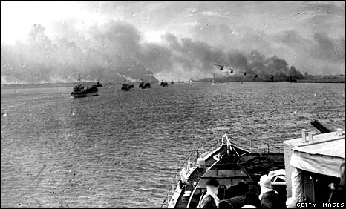

Slide 61
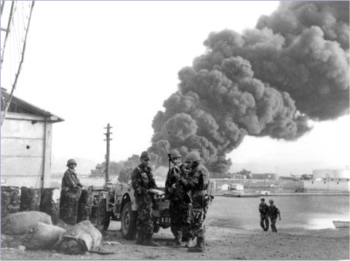

Slide 62
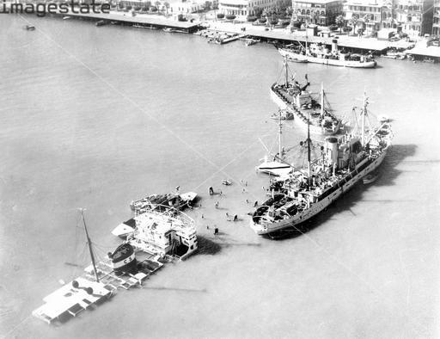

Slide 63
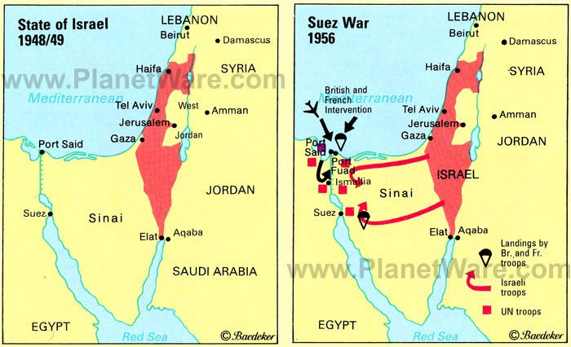

Slide 64
Revival of Pan-Arabism
Despite the military setback, Nasser emerged strong in the eyes of Arab World after Suez Crisis
It was with this momentum that he engaged Syria to form a unified “Arab” state:
in 1958, Syria and Egypt joined by forming the United Arab Republic (UAR) with Nasser as president
Other Arab leaders in Sudan, Libya and Yemen sought to form similar alliances as Pan-Arabism was at its apex
this was not about religious unity (unlike pan-Islamism) but more of an ethnic and political unity
With all the pomp and circumstance of Pan-Arabism in theory, the actual practice of it turned out to be more difficult than imagined.
Within three short years of the fragile union, Egypt and Syria parted ways.

Slide 65
Cold War Syria and Iraq
Unlike Egypt, Syria and Iraq are ethnically diverse.
Syria is a complex tapestry of Arabs with widely varying ideologies Sunnis, Shi’is, Druzes, Isma’ilis and others.
In addition there were scores of ethnic and religious minorities such as Catholics, Kurds, Turkomans, Circassians and Yazidis.
Another 10% are roaming Bedouins who are adept at causing divisiveness.
Syrians have never been able to speak with one voice as the individualism hinders their cooperation.
Furthermore, a particular sect may be unified with another for one cause and the opposed to it for another cause.
During a decade since Syria gained independence in 1946, there were nearly ten coup d’etats and about as many rewritings of the constitution.

Slide 66
Enter the Ba’ath Party
The Ba’ath (Resurrection) Party was formed in 1953 by the fusion of socialist, Pan-Arab parties one led by Michel Aflaq, a Christian and the other by Salah al-Bitar, a Sunni Muslim.
Their ideology was secular, Pan-Arab and called for nationalization of industry.
They at once identified with Nasser.
Their main rival was the Communist Party in Syria.
Ba’athist Parties were also formed in Iraq (Sadam Hussein’s party), Lebanon and Jordan.
It was the Syrian Ba’athists who, fearing a Communist Party coup in 1958, went to Cairo and proposed for a union with Nasser’s Egypt.

Slide 67
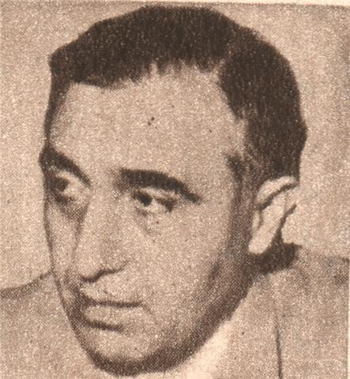
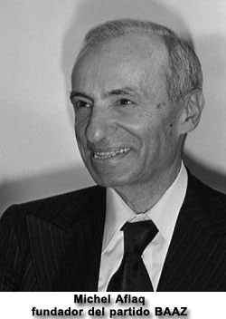
Founders of Ba’ath Party
Salah al-Bitar

Slide 68
Failure of UAR
Other groups in Syria such as moderates, businessmen, military leaders and conservatives realized that Syria was becoming a province of Egypt rather than a partner in a union.
Restrictions were placed on the economy according to Egyptian needs.
While the Ba’athists thought that things would work out for them in building the new National Union Party, Nasser never gave them the opportunity.
Indeed, in the first elections held within the UAR in 1959, the Ba’athists were pushed out of government altogether.
In addition, in applying his reforms to the UAR, Nasser failed to take into account the social, economic and agricultural differences between Egypt and Syria.
Nasser made friends with Syria’s enemies, namely King Hussein of Jordan, King Sa’ud of Arabia and worst of all the British!
The latter occurred when in June 1961, the British ended their protectorate over the oil-rich Kuwait and declared it to be independent.

Slide 69
Invasion of Kuwait by Iraq
After a successful coup, Iraq came under the Communist dictator General Abd al-Karim Qasim who executed the remnants of Faysal’s family
Iraq was second only to Syria in the number of coup d’etats in ten years, namely 8
In 1961, the British ended the protectorate of Kuwait and it became an independent state
On 25 June 1961, following Britain's relinquishing authority in Kuwait, Qasim announced that Kuwait would be incorporated into Iraq and the military threat was seen, by Britain, as imminent.
The reasons for Iraqi belligerence are debatable, but as well as the political gain to be accrued from a successful military campaign, Kuwait's assets at the time included possible oil reserves (confirmed later) and secure access to the sea, which Iraq lacked.
Britain had accepted responsibility for Kuwait's military protection and urgently sent a strong naval task force
this action alone prompted Qasim to withdraw his claim

Slide 70
Nasser’s Opposition to Iraq
Qasim was the sworn enemy of Nasser and thus Nasser could not allow Qasim to carry out his plan.
The Arab League took over the protection of Kuwait and the British had withdrawn its forces by 19 October
The Arab world was astonished to see Nasser send Egyptian troops to fight with the British against another Arab country!
The Syrians had enough. On September 28, 1961 Syrian officers stage a coup d’etat (#11) and forced the Egyptians to leave. The Ba’thist Party was reinstated.
Later, on February 8, 1963, the Ba’thists of Iraq staged a coup and executed Qasim and his Communist supporters.
They never again attempted a union and the three countries Iraq, Syria and Egypt vied with one another to lead the charge against Israel and dreamed of one day having a Pan-Arab state.

Slide 71
After the failure of the UAR, the unpopular involvement in the Iraqi-Kuwait dispute and yet another misadventure in Yemen, Nasser’s popularity and prestige began to wane.
Widely criticized, Nasser’s enemies outnumbered friends.
Palestinian activists were beginning to form and the Palestine Liberation Organization (PLO) accused frontline Arab states of forgetting their cause.
They intended to bring the region into war with Israel
Fedayi’in launched numerous guerilla attacks against Israeli targets.
Furthermore, Syria suffered as yet another coup d’etat in 1966, this time the leadership was more sympathetic to the Palestinian cause.
Alawis were Shi’i minorities in Syria and came to power with Ba’ath party
Invited the Soviet Union to supply them with modern arms, and the Soviets were more than happy to oblige.
Despite Nasser’s falling prestige, Ba’athist movements in Syria and Iraq were patterned after the Free Officers

Slide 72
Enter the Soviet Union
As if the Middle East were not already hopelessly complex, the entrance of the Soviet Union added yet another dimension
the socialist governments of Egypt and Syria and the Communists of Iraq were supplied with the latest Soviet military equipment including the infamous MiG-21 fighter aircraft, capable of speeds in excess of Mach 2.0

Slide 74
Brought to the Boiling Point
Adding to the tension which was already at a boiling point, there was a major dispute between Syria and Israel regarding water rights and border agricultural lands.
Israel began massing troops along the Syrian border.
In response, Nasser, not wanting to lose face and hoping that Israel would be deterred by a show of solidarity, entered into a mutual defense pact with Syria.
Despite a modest infusion of Soviet arms, Nasser realized that the combined Arab armies were woefully unprepared for war and unfamiliar with the latest Soviet weapons in their possession.
In the period between Israel’s War of Independence (1948) and the Six Day War (1967), the Syrians constantly harassed Israeli border communities by firing artillery shells from their dominant positions on the Golan Heights.
In October 1966 Israel brought the matter up before the United Nations.
Five nations sponsored a resolution criticizing Syria for its actions but it failed to pass due to a Soviet veto.

Slide 75
Brought to the Brink
When on April 7, 1967, Israel shot down six Syrian jets over Syrian territory in retaliation, Syria and Jordan criticized Nasser for not responding to defend Syria.
Instead, Nasser intended to intimidate Israel. Egypt’s troops mobilized to their border with Israel along the Sinai
Nasser called for removal of UN peace-keeping forces which had kept vigilance since 1956.
What happened next pushed Israel beyond the limit, Egyptian troops occupied Sharm al-Shayk controlling the Straits of Tiran of the Gulf of Aqaba.
On May 22, Egypt closed access to the Gulf of Aqaba to Israeli shipping and other shipping bringing supplies to Israeli port of Elat.
By the end of May Egypt was joined by Jordan and Iraq in an alliance to repel any attack on any of their members.
The Soviet Union was sympathetic with the Arab nations while the United States and Britain agreed with Israel that the closing of Aqaba, an international waterway, was an act of war.

Slide 76
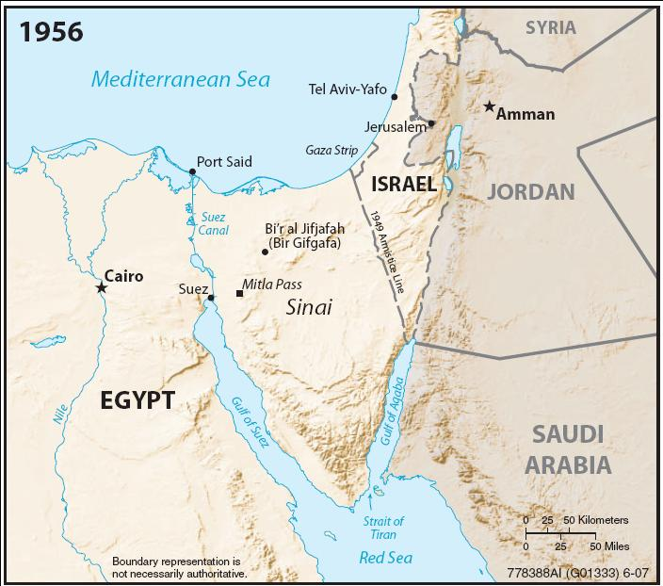

Slide 77
The Six-Day War
Israel was compelled to act preemptively against such overwhelming odds.
In a lightning stroke, Israeli air and land forces swept into Arab land from Sinai to Syria starting June 5, 1967.
In just two days Israeli jets annihilated the Egyptian, Syrian and Jordanian air forces mostly on the ground.
From then on, Israeli forces enjoyed unchallenged air superiority and devastated ground forces.
In six days the war was over. Israeli forces had taken the Sinai, West Bank and Golan Heights and annexed Old Jerusalem
at a cost of less than 1,000 killed, 4,517 wounded, 15 captured and 46 aircraft lost
while Arab forces suffered between 13,200–23,500 killed, 5,500+ captured, hundreds of tanks destroyed and 452+ aircraft destroyed.
Israel captured nine Egyptian generals, over 300 officers, and millions of dollars worth in state of the art Soviet equipment, most of it undamaged

Slide 78
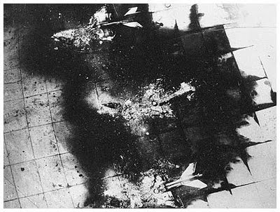

Slide 79
At the commencement of hostilities, both Egypt and Israel announced that they had been attacked by the other country. Once it was established that Israel had struck first, the Israeli government claimed that it was a pre-emptive strike in the face of a planned invasion by the Arab countries. On the other hand, the Arab view was that it was an unjustified attack. Sources support both positions.
On June 8, 1967 USS Liberty, a United States Navy electronic intelligence vessel sailing 13 nautical miles (24 km) off Arish (just outside Egypt's territorial waters), was attacked by Israeli jets and torpedo boats, nearly sinking the ship, killing 34 sailors and wounding 171.
Israel said the attack was a case of mistaken identity, and that the ship had been misidentified as the Egyptian vessel El Quseir.
Israel apologized for the mistake, and paid compensation to the victims or their families, and to the United States for damage to the ship.
After an investigation, the U.S. accepted the explanation that the incident was friendly fire and the issue was closed by the exchange of diplomatic notes in 1987. The surviving crew members still claim, and present some evidence, that the attacks might have been deliberate.

Slide 80
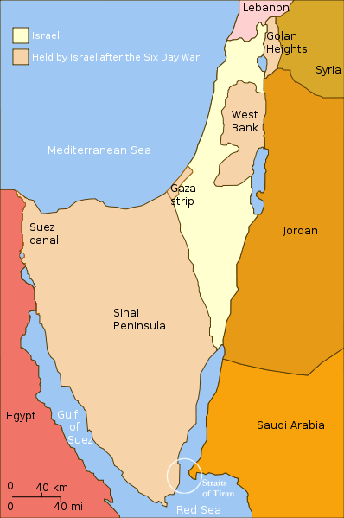
At the end, Israel occupied the entire former Palestine mandate. They had driven the Jordanians out of the West Bank and occupied Egypt’s Sinai, controlling entire eastern shore of Suez Canal

Slide 81
Aftermath of Six-Day War
At the end of Six-Day War, Israel had expanded their territory to unprecedented size
Jews could pray unhindered at Wailing Wall
Israel’s ships were free to sail Gulf of Suez
Elat could no longer be strangled at Straits of Tiran
Syrian artillery could no longer rain down from Golan Heights
but it did not bring peace
Arabs within occupied lands sympathized with Palestinian terrorists and harbored them

Slide 82
Security Council Resolution 242
adopted unanimously by the UN Security Council on November 22, 1967, in aftermath of the Six Day War
requires the establishment of a just and lasting peace in the Middle East which should include the application of both the following principles:
(i) Withdrawal of Israel armed forces from territories occupied in the recent conflict;
(ii) Termination of all claims or states of belligerency and respect for and acknowledgment of the sovereignty, territorial integrity and political independence of every State in the area and their right to live in peace within secure and recognized boundaries free from threats or acts of force."

Slide 83
Security Council Resolution 242
Israel interprets 242 as calling for withdrawal from territories as part of a negotiated peace and full diplomatic recognition.
withdrawal would not come before Arabs start to meet their own obligations that led to durable peace
the "Palestinian viewpoint" focus on the phrase in the resolution's preamble emphasizing the "inadmissibility of the acquisition of territory by war"

Slide 84
Security Council Resolution 242
on September 1, 1982 President Ronald Reagan said:
“In the pre-1967 borders Israel was barely 10 miles wide at its narrowest point. The bulk of Israel's population lived within artillery range of hostile Arab armies. I am not about to ask Israel to live that way again...So the United States will not support the establishment of an independent Palestinian state in the West Bank and Gaza, and we will not support annexation or permanent control by Israel.
There is, however, another way to peace. The final status of these lands must, of course, be reached through the give-and-take of negotiations; but it is the firm view of the United States that self-government by the Palestinians of the West Bank and Gaza in association with Jordan offers the best chance for a durable, just and lasting peace.
It is the United States' position that - in return for peace - the withdrawal provision of Resolution 242 applies to all fronts, including the West Bank and Gaza.
When the border is negotiated between Jordan and Israel, our view on the extent to which Israel should be asked to give up territory will be heavily affected by the extent of true peace and normalization and the security arrangements offered in return.
Finally, we remain convinced that Jerusalem must remain undivided, but its final status should be decided through negotiations.”

Slide 85
Security Council Resolution 242
"Land for peace" served as the basis of the Israel-Egypt Peace Treaty in 1979, in which Israel withdrew from the Sinai peninsula (Egypt withdrew its claims to the Gaza Strip in favor of the Palestine Liberation Organization).
Jordan renounced its claims regarding the West Bank in favor of the Palestine Liberation Organization, and has signed the Israel-Jordan Treaty of Peace in 1994, that established the Jordan River as the boundary of Jordan.

Slide 86
Six-Year Stalemate
Israel was prepared to negotiate implementation of the "land for peace" formula of resolution 242:
all the gained lands of ‘67 were up for barter…
except Jerusalem, as Capital of Israel, no part of it would be handed back to the Hashemite Kingdom Jordan
but as the Arabs were in no mood to negotiate, no part of land was relinquished.
Guerilla activity escalated bringing the area to the point of boiling over again, this time the pendulum of international sympathy swung toward the Arabs

Slide 87
Egypt’s War of Attrition
From 1969-1973, Egyptian guns bombarded and commandos raided Israeli positions along the canal
Unwilling to commit scarce ground forces to the length of the canal, Israel relied on air strikes to contain Egyptian forces west of Canal
Over 8,000 tons of bombs were expended in these raids and 150 Egyptian aircraft were shot down
Furthermore, Russian-built SAM-2 missiles were ineffective at defending against Israeli aircraft

Slide 88
Superpower Influence
Since 1955, the Soviet Union became more and more the opportunist supplier of Arab arms (Egypt, Syria and Iraq)
in exchange they received Egyptian cotton
acquired bases in Mediterranean for their fleet and airforces
economic and political interests in Suez Canal (Egypt) and Arab oil (Iraq)
Pretty much abandoned by France and Britain, Israel found the US its only ally
As US was winding down Vietnam, it freed up resources for Israel
In 1969, new F-4E Phantoms began arriving with President Johnson’s approval.
Thus by 1970, the Middle East was unwittingly polarized in the Cold War

Slide 89
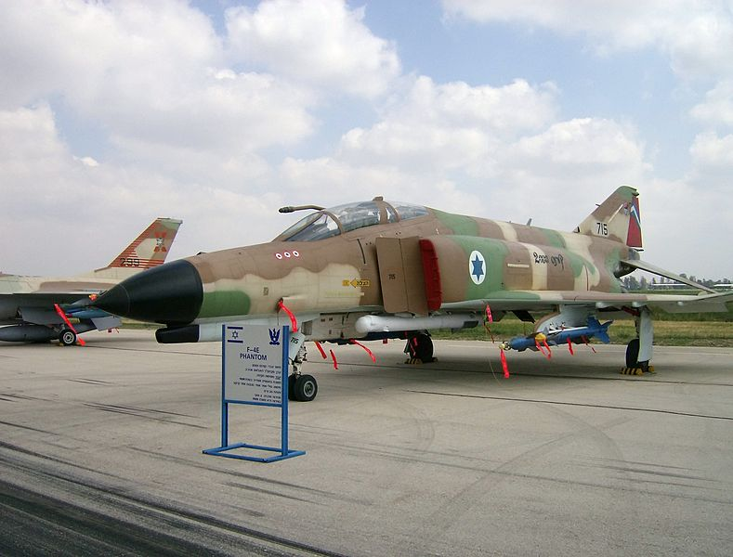

Slide 90
Superpower Influence
The Soviets saw an Arab-Israeli engagement as a test lab for their latest military technologies
by Summer 1973, they supplied Egypt with 2,100 and Syria with 1,700 new tanks: T-62s & T-55s
650 MiG and Sukhoi fighter-bombers were supplied to Egypt and another 350 to Syria
In 1970, Soviets agreed to meet Nasser’s request for better anti-aircraft weapons including improved SAM-2 and new SAM-3 missiles, formidable radar-directed 23-mm and 37-mm anti-aircraft guns
It was clear such technologies were useless in hands of those unfamiliar with them, so 15,000 Russians moved to Egypt to operate the SAMs and fly the latest versions of the MiGs.

Slide 91
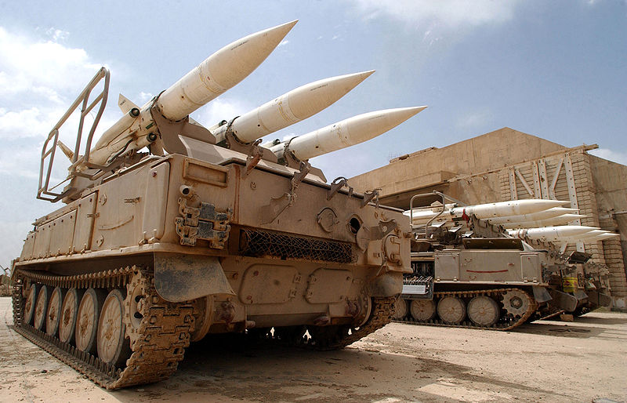
Soviet-made SA-6 SAMs

Slide 92
Superpower Influence
In contrast, the new President Nixon was unwilling to continue the flow of arms to Israel as he was embarked on a path of détente
But as tensions mounted, Israeli pilots engaged Russian pilots for the first time leading to an international crisis and potential confrontation between the US and Soviet Union

Slide 93
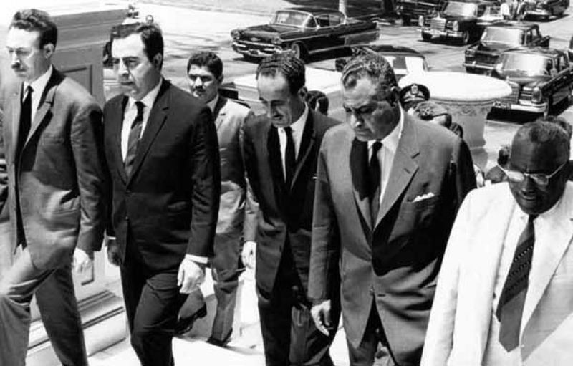
Nasser Dies
in June of 1970 Nasser sided with King Hussein of Jordan in acceptance of US Rogers Plan; called for end of hostilities in exchange for Israel’s withdrawal from Egyptian territory.
plan rejected by Israel and PLO as well as most Arab states
In retaliation, Palestinian Liberation Front hijacked and destroyed four international airliners on Jordanian soil
“Black September”, Hussein used Jordanian forces to rout Palestinian guerillas in Jordan
Escalations in violence brought the Middle East close to a wider war, prompting Nasser to hold an emergency Arab League summit on 27 September 1970
The next day, President Nasser suddenly died of massive heart attack. He was heavy smoker and workaholic.
Egypt and the Arab world was stunned
5 million attended his funeral including every Arab head of state and Soviet Premier Alexei Kosygin

Slide 94
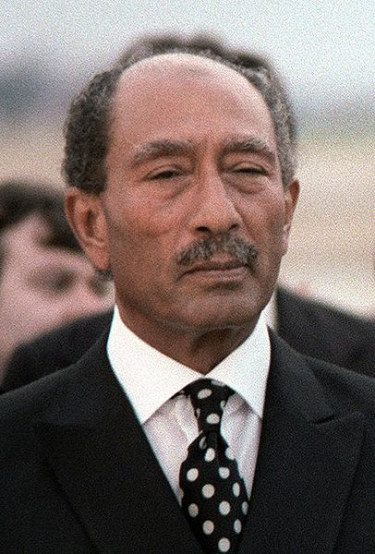
Nasser’s Successor
Although a member of the original 1952 Free Officers coup with Nasser and despite speeches to “continue the path of Nasser“
Vice President Anwar el-Sadat had very different goals
he took a dim view of “pan-Arabism” and Palestinian cause
he rejected negotiation and sought to regain territories lost to Israel
Sadat instituted political, economic, and foreign policies that exhibited significant departures from Nasserism
He continued along the path of Nasserism until after the 1973 War, when Sadat's domestic position improved immeasurably.
He felt far more empowered to move out of Nasser's shadow.
His departure from Nasserist policies became far more pronounced and far reaching
This angered a large segment of Egyptian society who saw the attempt as an assault on their national memory and political views.

Slide 95
The Russians Kicked Out
For whatever reason, the Soviets were ousted by Sadat in May 1971, whether it was:
growing Egyptian nationalism
condescending attitude of the Russians
reluctance of the Russians to allow Egypt to engage in another war with Israel
or US Secretary of State Henry Kissinger making it clear that Soviet military adventures in Middle East were incompatible with détente
Sadat declared that 1972 would “be the Year of Decision” and that “night will not last for long”
In 1973, he re-established ties with Saudi Arabia, Jordan then returned to Cairo for tri-partite summit with leaders of Egypt, Syria and Jordan to patch up relations.

Slide 96
Sadat’s Year of Opportunity
In 1973, it was a year of opportunity
Saudi Arabia supplied Egypt with the necessary cash and applied a new economic weapon against the US: oil
Arab leaders fully expected that threats to cut off oil supplies would precipitate an energy crisis in the West
Israelis were overconfident, expecting to repeat the victories of 1967
Bar Lev line of fortifications was expected to alert IDF of Egyptian attacks across Suez Canal
Israeli airpower was thought to be invincible, but had not tested the newest SAMs
on October 6th, Yom Kippur would be in full swing, Israel would be relaxed and unprepared, many reservists would be on holiday leave

Slide 97
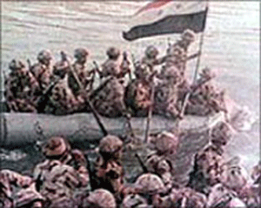
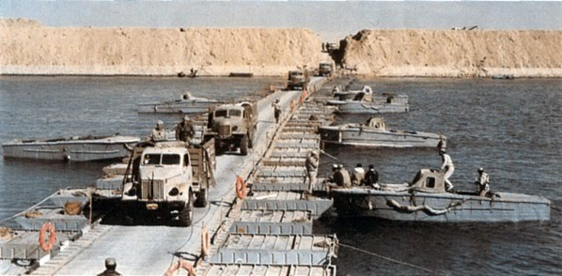
Yom Kippur (Ramadan) War
On Saturday, October 6, 1973, when both Jews and Arabs were supposed to be fasting (Yom Kippur and Ramadan coincided)
Egyptians poured across the canal, overwhelming outposts of Bar Lev line in minutes, Israeli tanks faced infantry equipped with Russian anti-tank missiles. Tanks were armed mostly with useless armor-piercing rounds.
anti-aircraft batteries & SAMs kept the Israeli air force from delivering the close support the ground troops had come to expect

Slide 98
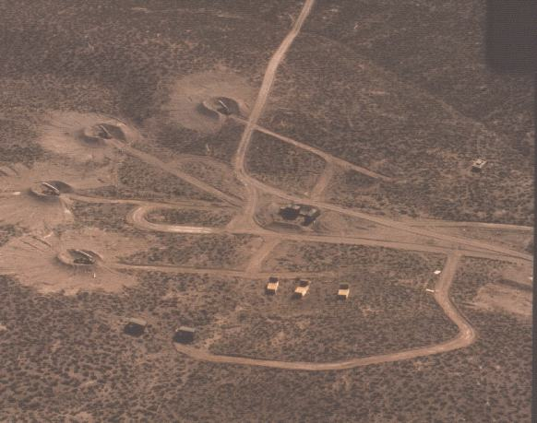
Into the Web
woven into a complex array of missile defenses, the Soviets supplied massive amounts of SA-2, SA-3 batteries and vehicle-mounted SA-6 SAMs
for days until the computerized control centers could be knocked out, Israel sustained heavy aircraft losses.
Prime Minister Golda Meir had insisted that Israel not take an aggressive posture in mobilizing reserves, thus once the attacks began, it took several days to bring Israeli forces to bear, just the break Arab forces hoped for
Meanwhile Syrian troops and armor poured into Galilee from Golan Heights

Slide 99
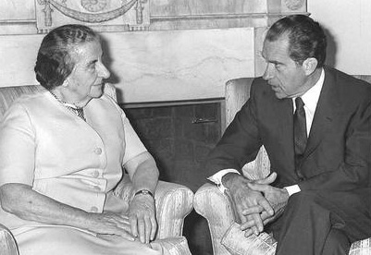
Arms Race
On Oct 9th, the Soviets began airlifting more equipment and supplies to Egypt and Syria
Syria alone had more tanks than Britain and France combined.
in desperation Mrs. Meir met with President Nixon to secure more Phantoms, tanks, artillery and missiles. Many US aircraft were pulled from US units and hastily flown to Israel to be repainted with star of David. These aircraft were equipped with electronic counter measures against Soviet SAMs and radar-directed guns
Ships brought in tanks, artillery, TOW missiles,
Other supplies were airlifted in. Operation Nickel Grass
On Oct 16th, Gen Sharon managed to cross the canal in a bold counter-offensive
before Egyptians could respond Israeli F-4s had knocked a hole in SAMs

Slide 100
To the Brink Again
, it was clear that Israel was in desperate straits and thus the US hastily infused a supply of
95 F-4E Phantom fighter-bombers
160 A-4 Skyhawk ground attack jets
electronic countermeasures against Soviet SAMs
850 Chieftain, M60 and M48 Patton tanks

Slide 101
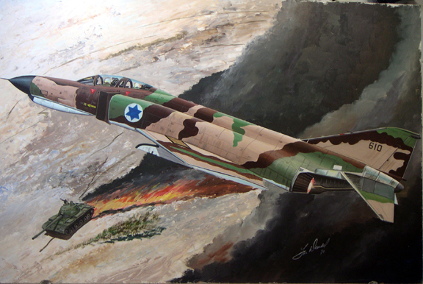

Slide 102
Counter Attacks
Now gaining momentum, Israeli forces began to encircle the Egyptian 3rd Army on the west-side of the canal
Sensing that things were getting desperate, Soviet Premier Kosygin flew to Cairo to meet with Sadat, while Israelis were just 100 miles away.
Kosygin ordered 400 Russian personnel back to Egypt to bolster air defenses around Cairo
Israeli forces considered attacking Russian ships that entered Port Said
With these turn of events, President Nixon decided the war must be stopped and sent Secretary of State Kissinger to Moscow
A joint UN proposal by the United States and the Soviet Union called for cease fire on Oct 22 passed the Security Council. Despite this, Israeli forces fought a vicious battle to retake Golan Heights from the Syrians.

Slide 103
Security Council Resolution 338
Adopted unanimously by the Security Council on October 22, 1973
1. Calls upon all parties to the present fighting to cease all firing and terminate all military activity immediately, no later than 12 hours after the moment of the adoption of this decision, in the positions they now occupy; 2. Calls upon the parties concerned to start immediately after the cease-fire the implementation of Security Council resolution 242 (1967) in all of its parts; 3. Decides that, immediately and concurrently with the cease-fire, negotiations shall start between the parties concerned under appropriate auspices aimed at establishing a just and durable peace in the Middle East.

Slide 104
Security Council Resolution 338
adopted on October 22, 1973, called for a ceasefire in the Yom Kippur War in accordance with a joint proposal by the United States and the Soviet Union.
Stipulated a cease fire to take effect within 12 hours of the adoption of the resolution.
The "appropriate auspices" was interpreted to mean American or Soviet rather than UN auspices.
This third clause helped to establish the framework for the Geneva Conference held in December 1973.
But on 22 Oct, Israel continued its campaign to secure the Golan from Syria.

Slide 105
Global War
Furious that the Israelis had committed a breach of the cease-fire, the Russians blamed the Americans and accused them of being deceitful
Soviet troops were mobilizing: Brezhnev sent a message: unless the Israelis were reeled in, Russia would send paratroops to protect Egypt
On October 25, 1973, American forces went to DEFCON 3 and all American strategic bombers and forces worldwide were placed on full alert. Kissinger and Nixon made it clear that US would react if the Soviets interfered with the Middle East war.
In order to avert international catastrophe, the UN began an emergency meeting to defuse the situation and a final cease fire was declared on October 26th

Slide 106
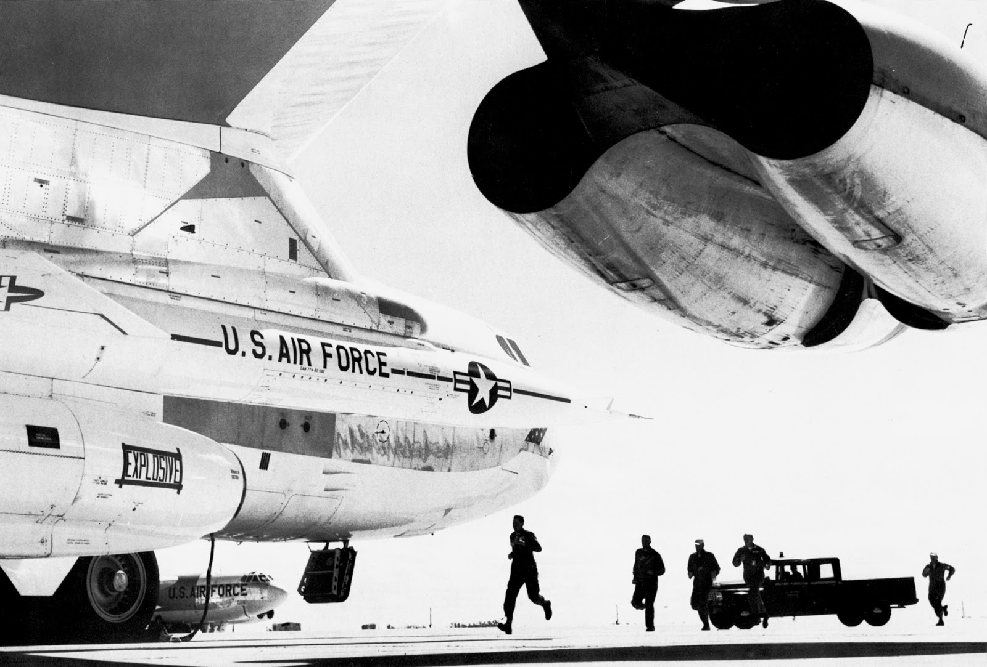

Slide 107
Gas Crisis
On October 18th, King Faysal of Saudi Arabia announced that oil production for the West would be continuously reduced until there was peace in the Middle East
Though United States was the initial target of the embargo, it was later expanded to the Netherlands
Price increases were also imposed. Since short term oil demand is inelastic, demand falls little when the price is raised. Thus, oil prices had to be raised dramatically to reduce demand to the new lower level of supply

Slide 108
Oil Prices 1881-2006

Slide 109
Gas Crisis Impact
U.S. actions seen as initiating the oil embargo and the long term possibility of high oil prices, disrupted supply and recession, a strong rift was created within NATO.
Additionally, some European nations and Japan sought to disassociate themselves from the U.S. Middle East policy.
Arab oil producers had also linked the end of the embargo with successful U.S. efforts to create peace in the Middle East
To address these developments, the Nixon Administration began parallel negotiations with both Arab oil producers to end the embargo,
and with Egypt, Syria, and Israel to arrange an Israeli pull back from the Sinai and the Golan Heights after the fighting stopped.
By January 18, 1974, Secretary of State Henry Kissinger had negotiated an Israeli troop withdrawal from parts of the Sinai.
The promise of a negotiated settlement between Israel and Syria was sufficient to convince Arab oil producers to lift the embargo in March 1974.
By May, Israel agreed to withdraw from some parts of the Golan Heights

Slide 110
Aftermath
1600 tanks were destroyed
449 Arab aircraft and 105 Israeli
Syrians and Egyptians suffered 15,000 casualties (5,000 killed) and Israelis lost 2,500
cost $5 billion
more than twice the number of tanks at El Alamein in WWII

Slide 111
Aftermath
Unlike the 1967 War, in the 1973 War, the Arab entities were Syria and Egypt with minimal participation by Iraq (sent 12 MiGs) and a token involvement by Jordan (dispatched an armored brigade)
For the first time, Israel was heavily supported by the United States.
The war was conceived and coordinated by Sadat and nearly succeeded in defeating the IDF initially.
The final outcome was somewhat of a draw, without major territorial gains on either side but it had profound impact upon all the parties involved in the Arab-Israeli conflict:
The ideas that Israel was invincible and that the Arab armies were incompetent were shattered.
However, even if Arabs could mount effective attacks against Israel, they could not overcome Israel with American military aid.
Both sides had mutual respect for the other’s potential and this opened doors for renewed negotiations which were previously closed.

Slide 112
Geneva Conference 1973
After considerable "shuttle diplomacy" negotiations by Henry Kissinger, the conference opened on 21 December 1973 under the auspices of the UN, with US and USSR as co-chairmen.
Foreign ministers of Egypt, Jordan and Israel were in attendance. The table with Syria's nameplate remained unoccupied, although Syria had indicated intentions.
Kissinger articulated his step-by-step strategy and stated that the goal of the conference was peace; the immediate need was to strengthen the cease-fire by accomplishing a disengagement of forces as the "essential first step" toward implementation of UN 242.
The meeting was then adjourned but paved the way for:
Sinai disengagement agreements with Egypt finalized in September 1974
Golan disengagement agreement with Syria in May 1974

Slide 113
Sadat Takes a New Tack
Sadat emerged as a new figure leading Arab politics.
He grew confident enough to pursue diplomacy independent of the other Arab contenders but in so doing only widened the breach between Egypt and the other Arab states.
Partly due to disagreements with Arab (mainly Syria, Libya, and Iraq) and communist allies, Egypt opted to settle a separate agreement with Israel instead of holding out for a comprehensive peace settlement involving the other the other Arab states.
With the ever-increasing importance of America’s involvement, Sadat realized that the only way to reclaim the Sinai was to prove his sincerity to both Israel and the US.

Slide 114
A Thawing Between Egypt & Israel
On November 19, 1977, Sadat shocked the world and flew directly to Jerusalem, which in effect was recognition of Israel as a state.
The basic message of Sadat's speech at the Knesset were the request for the implementation of Resolutions 242 and 338.
Like Sadat, Israeli Prime Minister Begin also saw many reasons why bilateral talks would be in his country's best interests:
It would afford Israel the opportunity to negotiate only with Egypt instead of with a larger Arab delegation that might make unwelcome or unacceptable demands.
Israel felt Egypt could help protect Israel from other Arabs and Eastern communists.
In addition, the commencement of direct negotiations between leaders – summit diplomacy – would distinguish Egypt from her Arab neighbors.

Slide 115
Sadat in Israeli Knesset 1977

Slide 116
Camp David Accords
In September 1978, US President Jimmy Carter invited Egyptian President Sadat and Israeli Prime Minister Begin to the Camp David retreat to work on the peace process.

Slide 117
Camp David Accords
The result was the Camp David Accords signed in March 1979 in which Israel agreed to a phased withdrawal from Sinai including 4,500 civilian inhabitants and restore it to Egypt in exchange for normal diplomatic relations with Egypt
guarantees of freedom of passage through the Suez Canal and other nearby waterways (such as the Straits of Tiran)
a restriction on the forces Egypt could place on the Sinai peninsula, especially within 20–40 km from Israeli border.
This process would take three years to complete.

Slide 118
Normal Relations Between Egypt & Israel
Israel also agreed to limit its forces 3 km from the Egyptian border, and to guarantee free passage between Egypt and Jordan.
With the withdrawal, Israel also returned Egypt's Abu-Rudeis oil fields in western Sinai, which contained commercially productive wells.
The normalization of relations between Israel and Egypt went into effect in January 1980:
Ambassadors were exchanged in February.
The boycott laws were repealed by Egypt's National Assembly
some trade began to develop, albeit less than Israel had hoped for.
In March 1980 regular airline flights were inaugurated.
Egypt also began supplying Israel with crude oil.

Slide 119
Egypt in Crisis
The years 1979-1980 brought trouble both without and within for Egypt.
Arab leaders met in Baghdad and (except for Oman and the Sudan)
all agreed on imposing economic, diplomatic and political sanctions against Egypt
and expelling Egypt from the Arab League.
Once the leader of Arab unity, Egypt was now virtually isolated from it.
Although most Egyptians received news of the peace accord well,
many were uneasy about the lack of settlement on issues regarding Palestinians, Gaza or the West Bank
as well as the loss of Egypt’s prestige in the Arab world.

Slide 120
Sadat’s Declining Popularity
Sadat became more authoritarian and intolerant
acquired a reputation for extravagance
There was rise in anarchy in Egypt due to the failure of socialism under Nasser and capitalism and Western aid under Sadat to generate noticeable economic improvements.
People groped for moral guidance. Almost 30 years of secular government under Nasser and Sadat had left the people in a state of religious malaise.
The Muslim Brotherhood which Nasser disbanded, Sadat allowed to resume with some activity as long as it didn’t become a political party.
It began a highly successful recruiting campaign among university students and recent graduates who were facing the realities of low-paying jobs.
Other more militant Islamic groups formed secretly, including al-Jihad (secret struggle) and al-Takfir wa al-Hijrah (Excommunication and Emigration).
These groups held in common the conviction that the present regime was impious, too flirtatious with the West (in particular the United States) and it was the duty of Muslims to overthrow the government and restore the preeminence of Shari’ah.

Slide 121
Sadat Assassinated
Residents of Cairo staged a number of anti-government protests. Some 1,500 arrests were made of members of various Islamic militant groups
On October 6, 1981, while viewing a military parade, Sadat was assassinated by a platoon of some 23 soldiers passing the review stands led by Lieutenant Khalid al-Islambouli, a member of al-Jihad.
Islambouli and three co-conspirators were tried and executed by firing squad but Islambouli is considered a martyr and there are “al-Islambouli brigades” in al-Qaeda

Slide 123
Mubarak Succeeds Sadat
Sadat’s successor was Vice President Hosni Mubarak, a professional soldier who had no political aspirations but was a strong leader.
A Soviet-trained fighter pilot, Mubarak served with distinction as commander of Egyptian Air Force during the 1973 war.
During his early years as the new President of Egypt, Mubarak appeared to be guiding the country toward democratic reform.
The elections of 1984 were the most open since 1952,
permitting the once disbanded Wafd party to participate.
The Wafd gained enough seats in Parliament to become the largest opposition group.
With time, Mubarak’s reluctance to support reform became apparent and his regime backed away from further political liberalization.
From government pressure via patronage or intimidation and from internal conflicts the Wafd was soon fractionated,
dampening public enthusiasm for the new regime and engendered apathy toward the electoral process.
The most persistent opposition to Mubarak’s regime came from diverse Islamic groups within the country.
How Mubarak managed to stay in power even to the present time reflects the power of the military in country.
The state deployed force to crush the more militant Islamic groups
while simultaneously attempting to co-opt more moderate political organizations.
Despite this, portions of Egyptian society embraced the Islamist programs.

Slide 124
Hosni Mubarak President 1981-2011

Slide 125
Mubarak Aligns with US
Mubarak’s foreign policy was constrained by the Camp Davis Accords, a budding relationship with the United States and a faltering economy.
These factors side-lined Egypt in the 1980’s during Israel’s invasion of Lebanon and diminished Egypt’s influence within the region.
Economic necessity compelled Mubarak to turn to America
many question the wisdom of what they considered subjecting Egypt to a new form of “Western imperialism”.
The Egyptian military received billions of dollars of aid from the United States each year, stemming from the Camp David Accords.
Despite these obstacles, Egypt’s reintegration in the Arab world was achieved by Mubarak through patience and methodical diplomacy.
Egypt was readmitted to the Arab league in 1989 and within two years, Cairo was restored to its former position as League headquarters.

Slide 126
Israeli Sinai Withdrawal
Following the Egyptian-Israeli peace treaty signed in Camp David in 1979, Israel began a phased withdrawal
Completed on April 25, 1982, Israel withdrew from Sinai to the 1949 border extending to Elat
Gaza was never annexed by Egypt, and since 1948, has never been legally recognized as part of any state
since 1967, nearly half of its population of 356,000 lived in refugee camps
Most recently, this population of Palestinian Arabs has risen to well over 1 million.

Slide 127
West Bank
Most troubling of occupied lands, the West Bank remained entirely under Israeli control from 1967 to 1993.
In 1988 King Hussein of Jordan announced he relinquished any claim on West Bank to wishes of Palestinian people for self-determination
In 1993, when Israel and Palestinian authorities reached an accord, seven towns were turned over to Palestinian control:
Jericho, Bethlehem, Jenin, Nablus, Qalqilya, Ramallah and Tulkarm
resumption of an “effective state of war” between Palestinians and Israel precluded further withdrawal as Israeli forces remain in many areas previously turned over to Palestinian authorities

Slide 128
Golan Heights
An interim status was set forth during disengagement agreement between Syria and Israel in May 1974
UN administration of an Eastern Strip
In December 1981, the area was placed under Israeli law, jurisdiction and administration
largely Druze with a few Israeli settlers, total population numbers 25,400

Slide 129
Syria’s Plight
In 1966, Alawi-oriented military officers successfully rebelled and expelled the old Ba'ath that had looked to the Christian Michel Aflaq and the Sunni Muslim Salah al-Din al-Bitar for leadership.
They promoted Zaki al-Arsuzi as the "Socrates" of their reconstituted Ba'ath Party.
The Assad family takes power
In 1970, then-Air Force General Hafez al-Assad, an Alawite, took power and instigated a "Correctionist Movement" in the Ba'ath Party.
His coming to power has been unprecedented development shocking to the majority population which had monopolized power for so many centuries.“
In 1971 al-Assad became president of Syria, a function that the Constitution allows only a Sunni Muslim to hold.
In 1973 a new constitution was published that omitted the old requirement that the religion of the state is Islam and replaced it with the statement that the religion of the republic's president is Islam.
Protests erupted when the statement was altered
to satisfy this requirement in 1974, Musa Sadr, a leader of the Twelvers of Lebanon and founder of the Amal Movement who had earlier sought to unite Lebanese Alawis and Shias under the Supreme Islamic Shiite Council without success, issued a fatwa stating that Alawis were a community of Twelver Shia Muslims.
Under the dictatorial but secular Assad regime, religious minorities were tolerated, political dissent was not.

